Slide 1
Developing Scientific Literacy

Slide 2
Session Aims
Identify challenges associated with integrating literacy into science lessons
Explore strategies and resources for supporting the development of literacy within science

Slide 3
Numbered heads
Number yourselves 1 to 4
You have 1 minute reading time
1 minute thinking time to summarise the key points
2 minutes to stand up, share points and decide the order
1 minute to write a sentence to summarise each section
A numbered person will be chosen randomly to share your ideas

Slide 4
D A C B
Improving literacy in secondary schools: a shared responsibility (OFSTED, 2013)
https://www.gov.uk/government/uploads/system/uploads/attachment_data/file/413182/Improving_literacy_in_secondary_schools.pdf

Slide 5
Challenge
Think about your own practice…
What challenges stand in the way of integrating literacy in science lessons?
Discuss and list as a group.

Slide 6
Collaborate with the English department
Talk with the English department. What strategies do they use to develop and support writing?
Can they be adopted in science for mutual reinforcement?
Remember to PEE!
Point
Evidence
Explain
(Link)
VCOP
Vocabulary
Connectives
Openers
Punctuation

Slide 7
Word activities for each topic
Create key word activities for each topic
One off task, which if split amongst the department isn’t too onerous
Could be printable or projectable

Slide 8
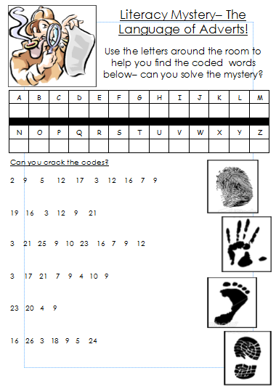
Literacy activities

Slide 9
Scaffolding and support
ACID
A Scaffold/guide for planning and structuring extended writing can be found on page 32/33 of the Student guide to literacy in Science.
FORCES
Another approach is using hexagons…
Choose a topic
Think of as many key words for that topic as you can
Write one key word per hexagons
Place hexagons with words which link together, next to each other
Describe the links/connections
Use this as the basis for writing an explanation
CELL

Slide 10
Literacy Mat
After seeing a few examples of Literacy Mats use the template to create one of your own…
It could be to support:
A specific topic
Writing up an investigation
Writing a piece of extended writing

Slide 11
Exam board quotes AQA Biology Higher 2014
Poor use of terminology – (BL1HP Q4di) many students using words like treating, curing or fighting, rather than killing pathogens and in (BL1HP Q4dii) bacteria becoming immune or infections developing resistance
Spelling errors – For example words such as glygogon or glucogen when describing how the body responds when the blood glucose concentration begins to decrease (BL3HP Q6b) make answers too ambiguous to award marks.
Explain questions
In general students did not realise the meaning of this command word and described rather than explained.
• For example in BL1FP Q2bii many students described the diagram rather than explaining and linking the information about more light being needed to allow more photosynthesis
• In BL3FP Q5b students quoted information from the stem without expanding on their explanation

Slide 12
Examiner report AQA Chemistry 2014
Experimental skills
• When asked to write conclusions that could be made from a paper chromatography experiment, some students simply wrote observations (CH2HP Q6b).
When asked to explain, many students simply recalled facts without explaining why they are important. When asked why iodine does not react with sodium bromide solution, many simply referred to the positions of elements in Group 7 of the Periodic table, without answering why a reaction would not take place (CH3FP Q1dii).
Students used imprecise language to describe the shape of a graph, rather than the relationship that the graph represented (CH3FP Q4b).

Slide 13
Command words

Slide 14
TELEPHONE
EMAIL
TWITTER
01423 206200
admin@smart-learning.co.uk
@smartlearning @smartsci @smartenglishsl
ADDRESS
Smart Learning Ltd Unit 4A Follifoot Ridge Business Park Pannal Road, Harrogate, HG3 1DP

